Slide 1

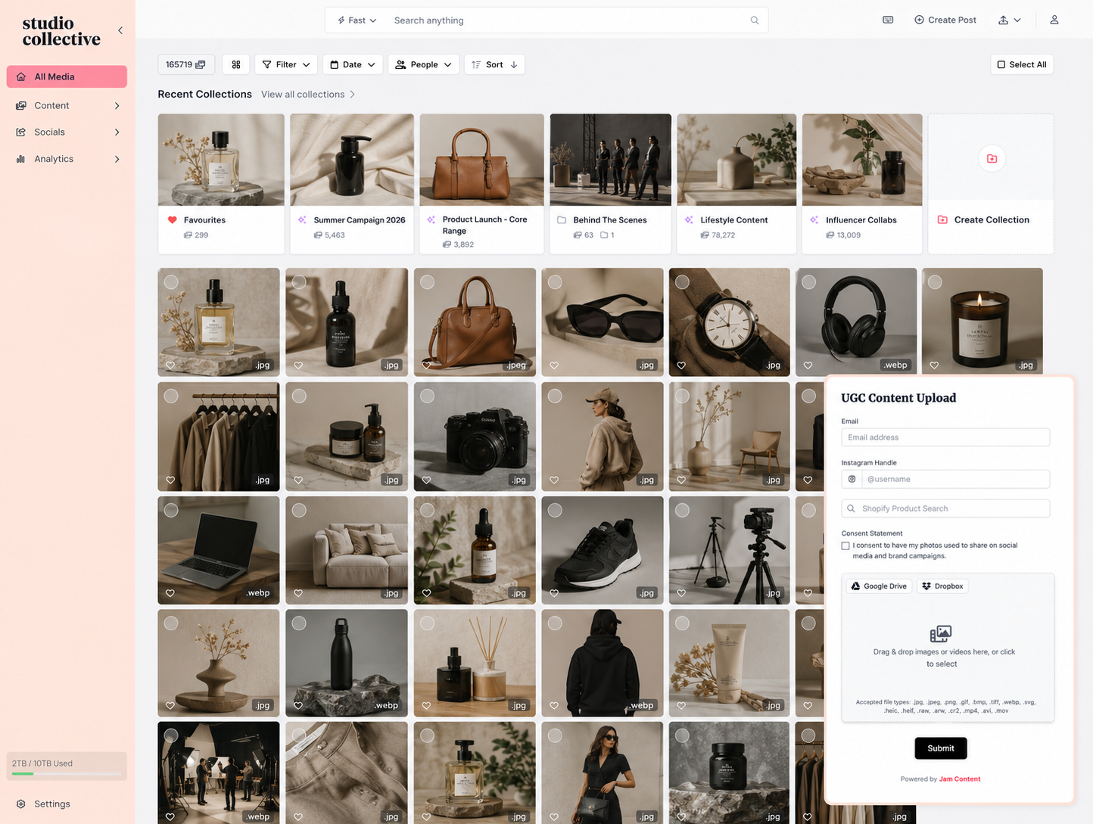
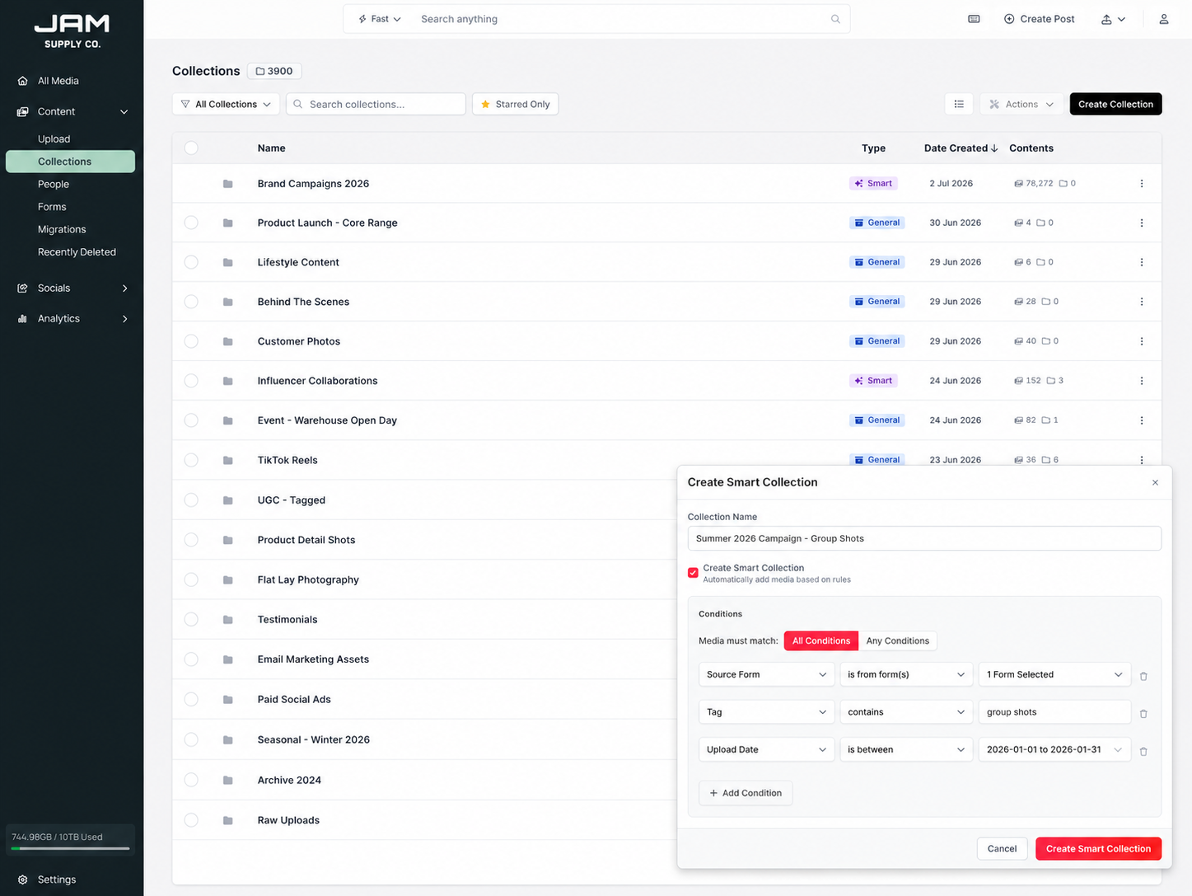
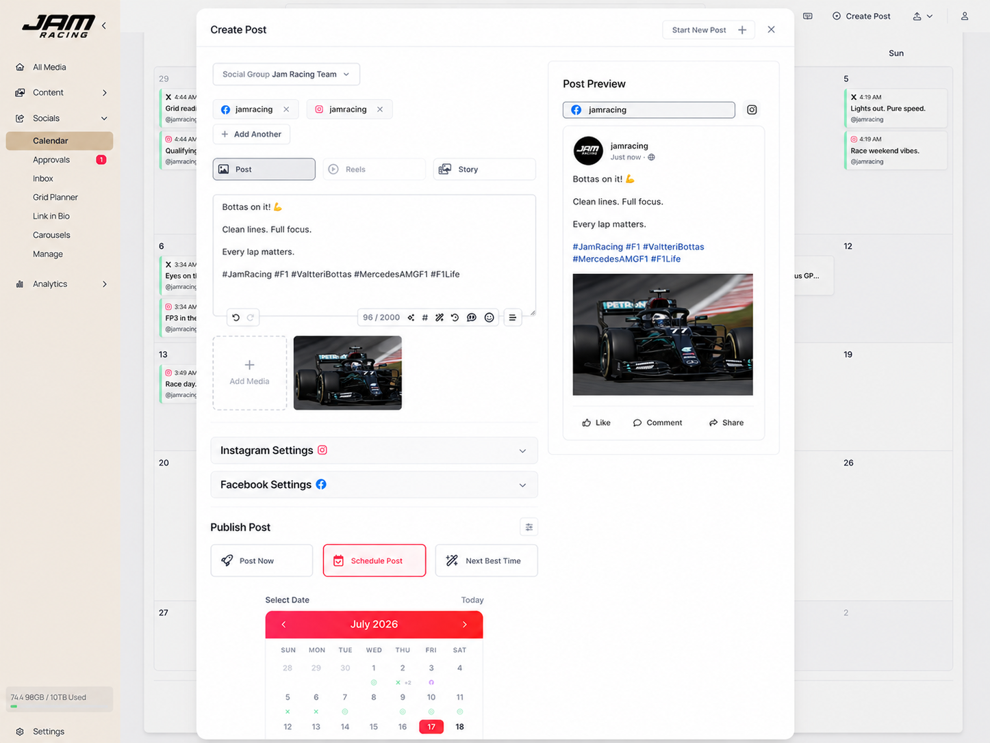
Collect. Organise. Publish.
Bringing your whole brand's content workflow in one workspace.

Slide 2

HOW JAM WORKS
Three steps, one workspace.
01
02
03
Collect
Organise
Publish
UGC forms, imports and drops - every asset flows into one library.
AI tagging, smart collections and search that actually finds things.
Approvals, scheduling and analytics across every platform.
2

Slide 3











Brands We Jam With
“The speed is the real game changer. Getting our content from our shoots live on Shopify used to take days, and now it happens in minutes.”
John Halias
COO, Girls With Gems
3

Slide 4
01
STEP 01
Collect Media
Bring photos and videos in from anywhere - one library, one source of truth.
4

Slide 5
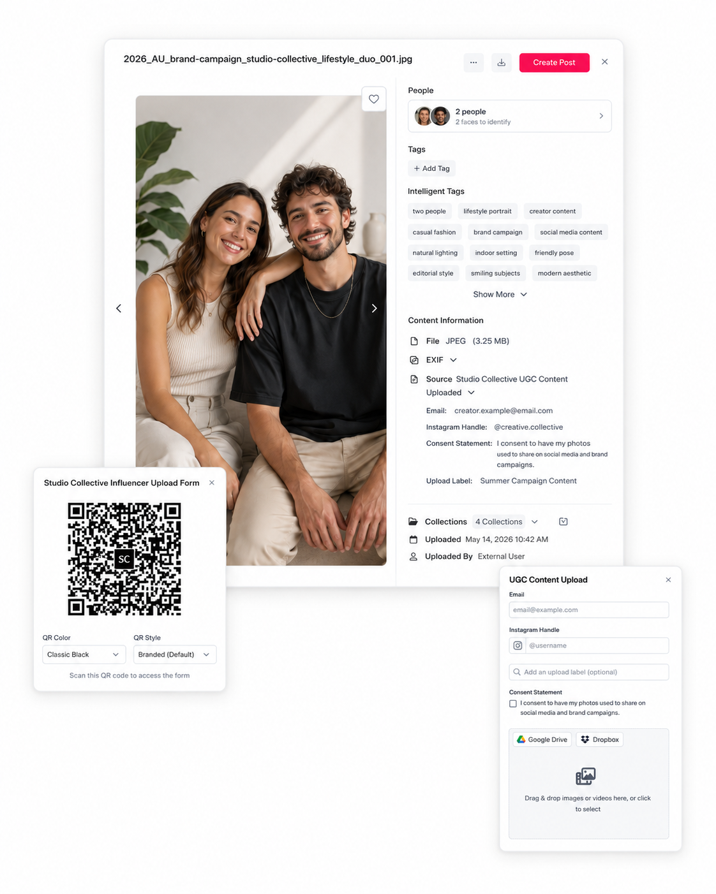
STEP 01 · COLLECT
Collect
● Upload
No size limits and support for every image and video format - including RAWs.
● User Generated Content (UGC)
Collect the content your community creates - upload forms, tagged posts and mentions, straight from your socials.
● Shopify Product Tag
Tag media to your Shopify products so every asset is linked to what it features.
● iOS & Android App
Capture and upload on the go - photos land straight in your library.
Learn more: jamcontent.com/collect
5

Slide 6
02
STEP 02
Organise Your Content
AI-powered search and smart collections, so anyone can find anything in seconds.
6

Slide 7
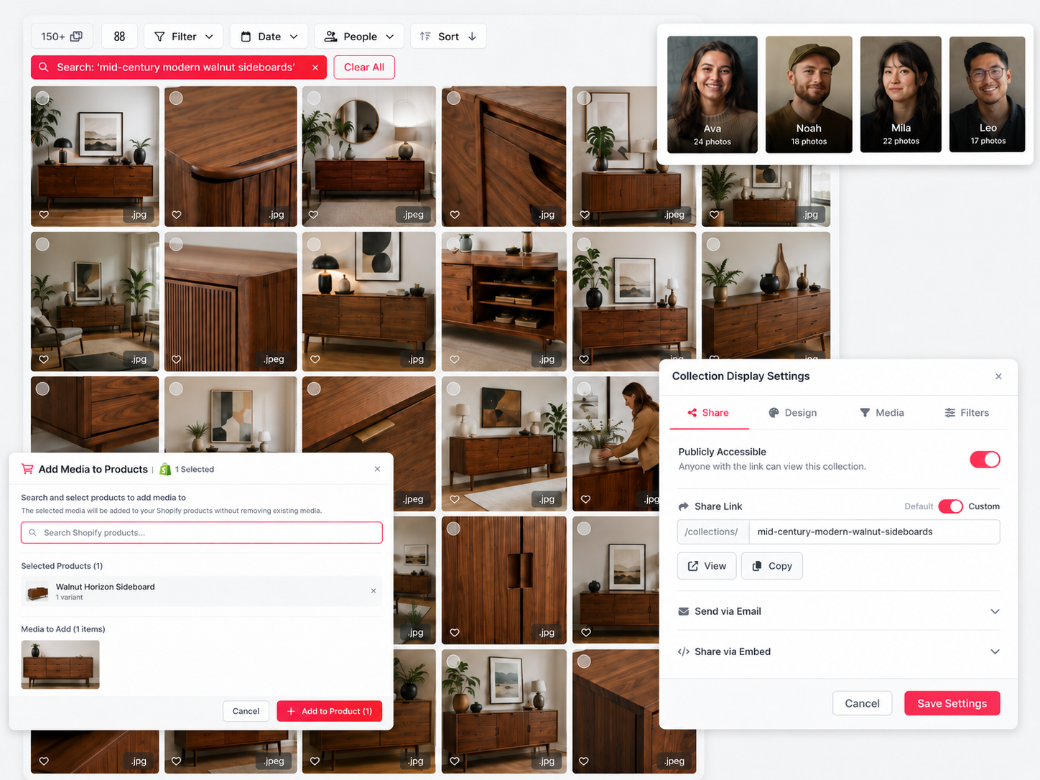
STEP 02 · ORGANISE
Organise
● Organising, Searching, Filtering
AI tags every file automatically, so you can search by what is actually in the shot.
● Collections
Group media into shared collections for campaigns, events and teams.
● Smart Collections
Set the rules once and new media sorts itself into the right place.
● People Face Detection
Find every photo of a person in one click with automatic face matching.
Learn more: jamcontent.com/organise
7

Slide 8
03
STEP 03
Share to Your Socials
Plan, schedule, publish and reply - all without leaving Jam.
Instagram · Facebook · TikTok · LinkedIn · YouTube · X · Pinterest
8

Slide 9
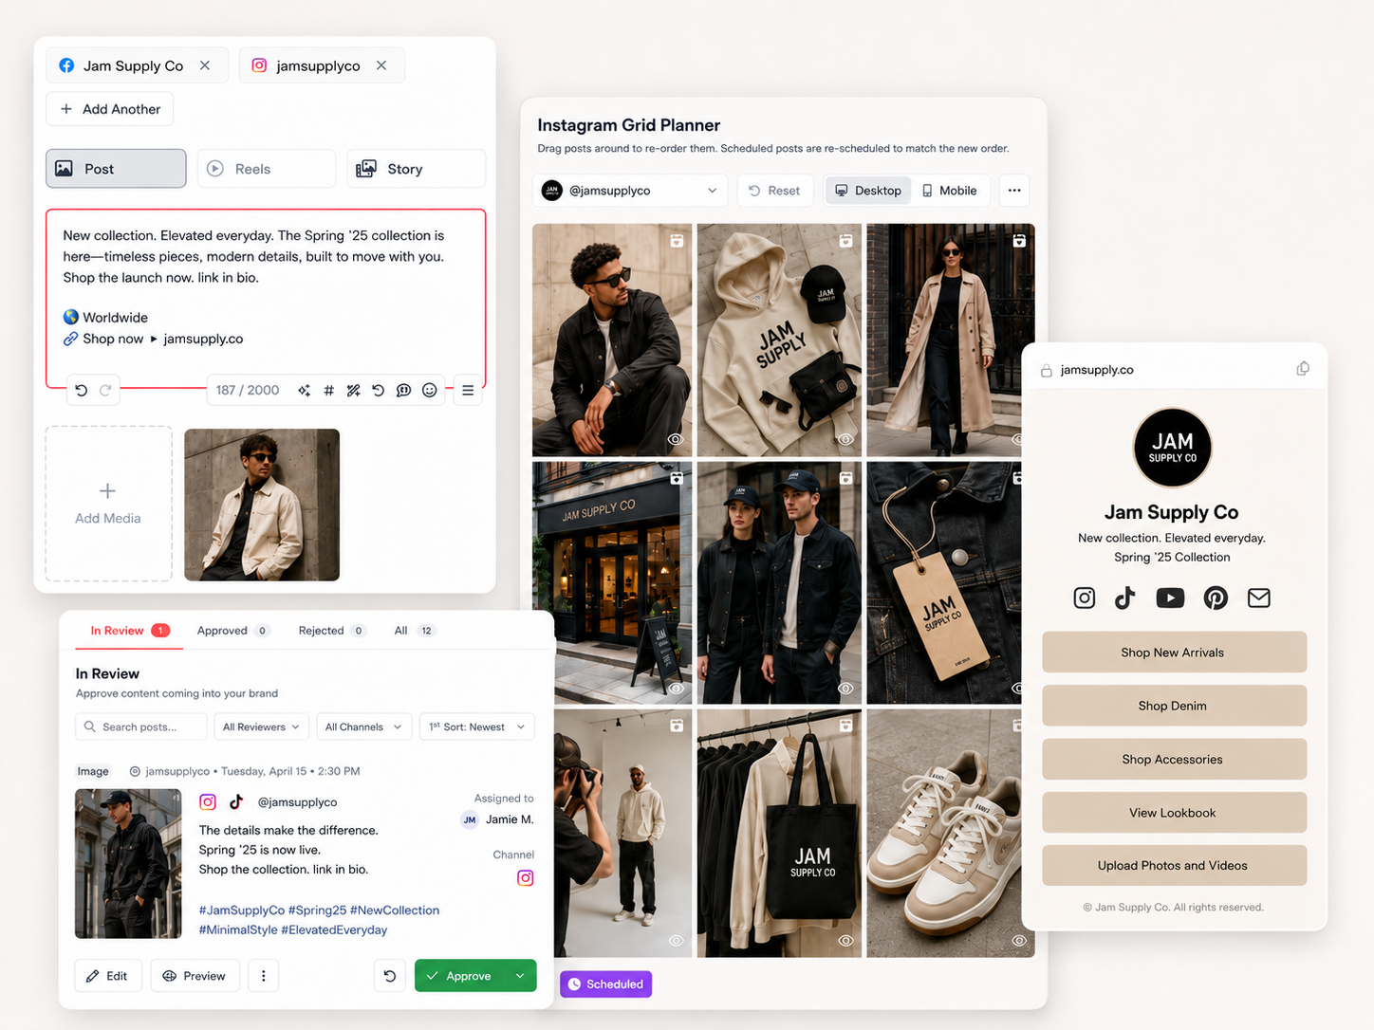
STEP 03 · SHARE & ENGAGE
Share & Engage
● Scheduling & Posting
Plan your calendar and publish to every platform at the right time.
● AI Auto Caption & Attribution
Generate on-brand captions and credit original creators automatically.
● Social Inbox
Reply to every comment, DM and mention from a single inbox.
● Link in Bio
Turn the link in your bio into a trackable, clickable landing page.
Learn more: jamcontent.com/social-scheduling
9

Slide 10


















INTEGRATIONS
Works with your stack.
Connect Jam with all your favorite platforms.
SOCIAL
Instagram
Facebook
TikTok
LinkedIn
YouTube
X
Pinterest
Google Business
CONTENT
Google Drive
Dropbox
Box
Iconik
Shopify
Canva
Unsplash
Slack
Claude
ChatGPT
From DAM to Jam. We can migrate from any platform and integrate to Jam.
10

Slide 11















USE CASES
How teams Jam.
Events & Sports
Ecommerce Brands
Agencies
Capture every moment on the ground, find every face, and share highlights while the crowd is still buzzing.
Every product shoot, campaign and UGC drop in one library - with media synced straight to your Shopify products.
Keep every client's media organised in collections, route posts through approvals, and publish across every channel.
Upload form & QR code
Shopify product tag & sync
Shared collections
iOS & Android capture app
User generated content (UGC)
Post approvals
People face detection
AI captions & attribution
Scheduling & posting
AI tagging & search
Smart collections
Social inbox
Shareable galleries
Link in bio
AI auto captions
Scheduling & posting
Scheduling & posting
Analytics
11

Slide 12












FOR LARGER TEAMS
Jam Enterprise.
Additional features, services and support for enterprise customers.
Custom domains & whitelabelling
Dedicated customer support
Cold archival storage
Full team training
Single sign-on (SSO)
Full API & MCP access
Custom integrations
Audit logs & activity history
Granular user permissions
Localised Storage (AU, US, EU, UK)
Complimentary DAM / storage migration
Enterprise SLAs
12

Slide 13

ABOUT JAM
From Sydney. Founded in 2024.
The next generation of content management and social publishing, built on modern architecture by a technical team with deep experience across major events, sports and ecommerce brands.
100% Developed and Supported in Australia
3M+
photos & videos processed by Jam's AI tagging pipeline
200K+
people interacting with shareable collections & galleries in the last 12 months
10,000+
social media posts published with Jam
150+
countries engaging with galleries embedded on brand websites
13

Slide 14
jam.
Ready to Jam?
Collect UGC, organise media, manage approvals and publish from one simple workspace - powered by Jam AI to help you find, tag and rediscover your best content faster.
hello@jamcontent.com
jamcontent.com

